Slide 1
Ready to use Polling questions for Internal Comms and Town hall meetings
Preprogramed PowerPoint Live Polling slides for use with Meetoo ‘Complete’ PPT add in and Meetoo
For explanation on why these questions work and tips for implementing them read our accompanying guide: The 5 Killer questions for employee comms meetings people will WANT to attend

Slide 2
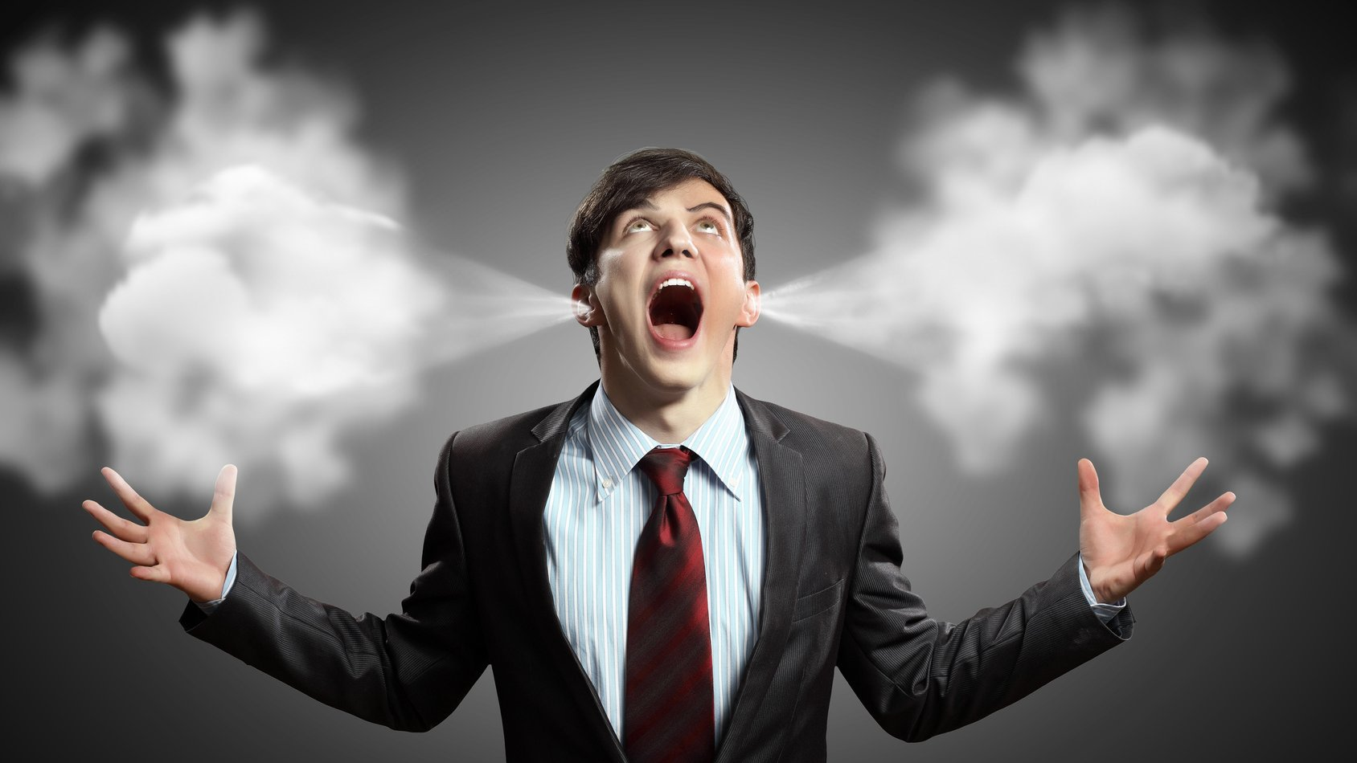
1. ‘Let it all out’ questions…

Slide 3
Please help set the agenda for the meeting by sharing your thoughts or questions
Please submit your responses via the Meetoo discussion board
Feel free to submit more than one question or comment
What IS working well in the company?
What are your suggestions for improvement?
What is NOT working well in the company?
What are the greatest organizational challenges you see?
What questions or issues do you want us to address in the upcoming Town Hall meeting?

Slide 4
2. ‘Do they understand’ questions

Slide 5
How clear are you on the strategy?
POLL OPEN
1.
Very clear
5%
2.
Quite clear
46%
3.
Somewhat unclear
7%
4.
Not clear at all
42%
Sample Results
Vote Trigger

Slide 6
How far off target are we currently for the year?
POLL OPEN
1.
More than 10% under target
19%
2.
Between 1% and 10% under target
33%
3.
On target
14%
4.
Between 1% and 10% over target
34%
5.
More than 10% over target
0%
Sample Results
Vote Trigger

Slide 7
The 3 headline features included in the Q3 product release will be...
POLL OPEN
Vote for up to 3 choices
1.
Upgraded PowerPoint add-in
4%
2.
Blackberry native app
34%
3.
Instant word clouds
14%
4.
Self paced/survey questions
28%
5.
Netflix integration
20%
(% = Percentage of Voters)
Sample Results
Vote Trigger

Slide 8
Please vote
POLL OPEN
1.
Yes
0%
2.
No
0%
3.
Don’t know
0%
Vote Trigger

Slide 9
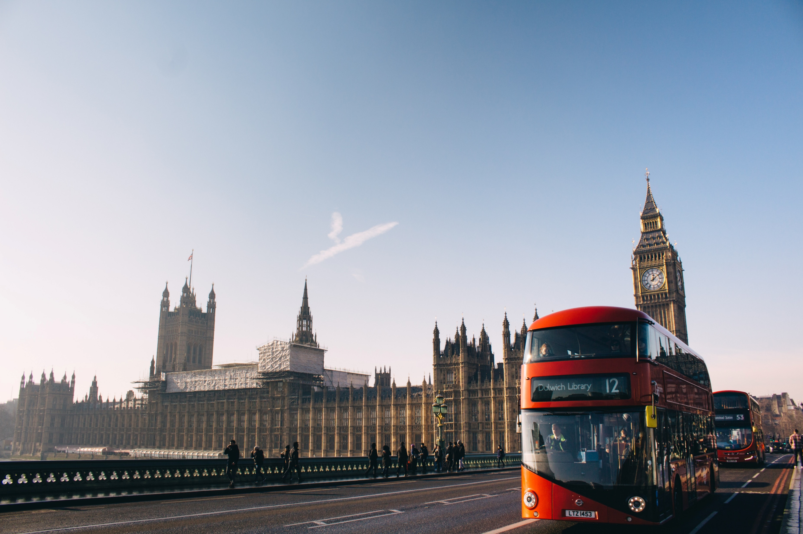
3. ‘On the Bus’ questions

Slide 10
How confident are you that this strategy can be successful?
POLL OPEN
1.
Not at all
12%
2.
Slightly
29%
3.
Reasonably
6%
4.
Very
34%
5.
No doubts at all- we can't lose!
19%
Sample Results
Vote Trigger

Slide 11
How excited and motivated do you feel about the new strategy?
POLL OPEN
1.
I don't
9%
2.
A little
39%
3.
Reasonably
6%
4.
Very
46%
Sample Results
Vote Trigger

Slide 12
Please vote
POLL OPEN
1.
Strongly disagree
0%
2.
Disagree
0%
3.
Neither agree nor disagree
0%
4.
Agree
0%
5.
Strongly agree
0%
Vote Trigger

Slide 13
4. The ‘Was it worth it’ question
Note: It may be appropriate to ‘hide’ the results of these polls until after the meeting has closed. The following examples have been set up in this way.

Slide 14
Was this session a good use of your time?
POLL OPEN
1.
No, not at all
17.65%
2.
A little
29.41%
3.
Quite
35.29%
4.
Extremely
17.65%
DATA CAPTURED THANK YOU
Vote Trigger

Slide 15
How would you rate this meeting?
POLL OPEN
1.
Waste of time
15%
2.
Somewhat useful
25%
3.
Useful
24%
4.
Very useful
36%
DATA CAPTURED THANK YOU
Sample Results
Vote Trigger

Slide 16
What were the 2 most useful or interesting parts of the meeting for you?
POLL OPEN
Vote for up to 2 choices
1.
CEO presentation
3%
2.
Seeing the revenue figures and targets
22%
3.
Marketing presentation
8%
4.
Product roadmap
24%
5.
Q&A session
43%
(% = Percentage of Voters)
DATA CAPTURED THANK YOU
Sample Results
Vote Trigger

Slide 17
5. ‘What’s next?’
questions

Slide 18
What would you like to learn or hear about in the next meeting?
Please submit your responses via the discussion board
Feel free to submit more than one suggestion
You may ‘Like’ any other suggestion that you agree with

Slide 19
How often should we hold these meetings?
POLL OPEN
1.
Weekly
4%
2.
Monthly
30%
3.
Quarterly
3%
4.
Bi-annually
28%
5.
Annually
35%
Sample Results
Vote Trigger

Slide 20
Name one thing that you what will you do differently as a result of this meeting?
Please submit your response via the discussion board

Slide 21
Appendix: Using Meetoo

Slide 22
A checklist to get you started…
Using these interactive slides is simple:
Copy and paste them into any PowerPoint slide deck to turn your existing meeting into a more interactive experience.
You can of course reword any of the questions to suit your meeting.
You will need:
A Meetoo Account: Sign up at meetoo.com
The Meetoo PowerPoint Add-in: Download here

Slide 23
Introducing the app
When using audience engagement technology, it is vital to introduce it properly. Little or no introduction can result in low participation rates and diminishes much of the value.
A good introduction will contain the following elements:
What the technology is and does
How to access it (i.e. App download instructions and/Or WebApp link, meeting ID)
Why you are using it at this meeting
The benefits of employee participation to the company/meeting/presenters
The benefits of participation to the employees themselves
A demonstration to show it is real and easy (e.g. warm-up poll and/or messaging test)
Encourage participation (best to come from meeting Host and/or presenters… and regularly)

Slide 24
Download Meetoo from your app store
and enter meeting ID:
XXX-XXX-XXX
Or on your mobile browser visit:
https://web.meetoo.io/XXXXXXXXX
web.meetoo.io/XXXXXXXXX
Notes:
Example of a slide to introduce the app and get the audience connected
Input your own meeting ID

Slide 25
Resources and links
More presentations containing ready to use polling question slides:
http://www.meetoo.com/resources/presentations
Tutorials and webinars on the Meetoo YouTube Channel
https://www.youtube.com/channel/UCfY9fvdNgd59-N4i9c_Jh_Q
Meetoo website for account sign up and PowerPoint add in
www.meetoo.com

